Slide 1
Memory Management
Manish Shrivastava

Slide 2
Why?
The programs are in the Main memory
We need a memory management scheme to manage several processes in the main memory
Main memory is very small
Secondary storage is used to support main memory
We also need file management for on-line storage of access to both data and programs that reside on disk

Slide 3
Memory is shared by multiple processes
We discuss various ways to manage memory.
Outline
Background
Address binding
Dynamic loading and linking
Overlays
Swapping
Memory management approaches
Contiguous Allocation
Paging
Segmentation
Segmentation with Paging

Slide 4
Memory Protection
Must provide memory protection at least for the interrupt vector and the interrupt service routines.
In order to have memory protection, add two registers that determine the range of legal addresses a program may access:
Base register – holds the smallest legal physical memory address.
Limit register – contains the size of the range
Memory outside the defined range is protected.

Slide 5
Memory is a central part of modern computer systems
Large array of bytes and words each with its own address.
CPU fetches and executes instructions
After the operation, the result is stored back into memory
Memory unit sees only stream of addresses.
Program resides on the disk.
Program must be brought into memory and placed within a process for it to be run.
Input queue – collection of processes on the disk that are waiting to be brought into memory to run the program.
User programs go through several steps before being run.

Slide 6
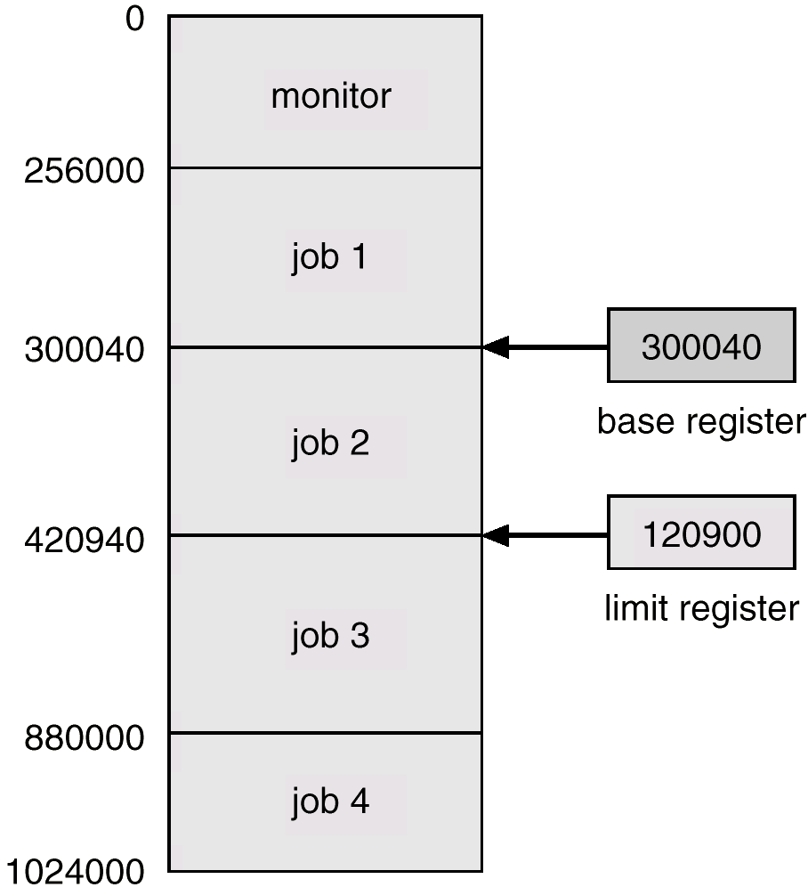
Use of A Base and Limit Register

Slide 7
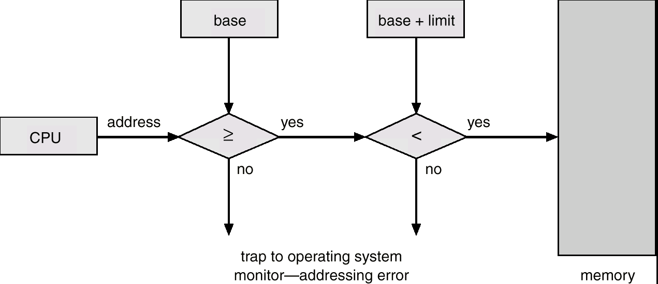
Hardware Address Protection

Slide 8
Memory Protection
When executing in monitor mode, the operating system has unrestricted access to both monitor and user’s memory.
The load instructions for the base and limit registers are privileged instructions.

Slide 9
Address binding
Most systems allow user process to reside in any part of the physical memory.
Address space starts at 00000; However, the first address of user process may not start at 00000.
So user program will go through several steps.
Addresses in the source program are symbolic.
Example: Count
A compiler will bind these addresses to re-locatable addresses.
Example: 14 bytes from the beginning of the module.
A linkage editor or a loader will bind these re-locatable addresses to absolute addresses.
A binding is a mapping from one address space to another.

Slide 10
Binding of Instructions and Data to Memory
Compile time: If memory location known a priori, absolute code can be generated; must recompile code if starting location changes.
MSDOS.COM-format programs are absolute code bound
Load time: Compiler must generate relocatable code if memory location is not known at compile time.
Final binding is delayed until load time.
If the starting address changes, we need only to reload the user code to incorporate the changed value.
Execution time: Binding delayed until run time if the process can be moved during its execution from one memory segment to another.
Need hardware support for address maps (e.g., base and limit registers).
Most OSs use this method.

Slide 11
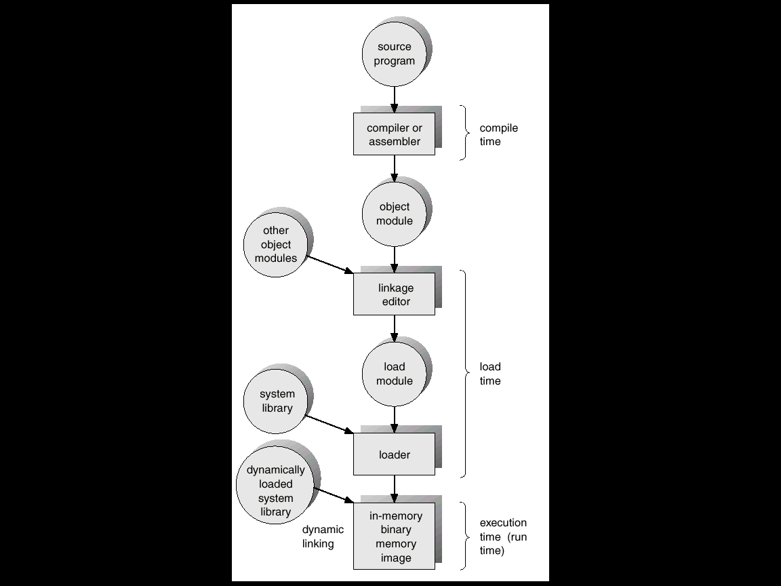
Multi-step Processing of a User Program

Slide 12
Dynamic Loading
Dynamic loading is used to obtain better memory-space utilization
Routine is not loaded until it is called
All routines are kept on disk in a re-locatable load format
Better memory-space utilization; unused routine is never loaded.
Useful when large amounts of code are needed to handle infrequently occurring cases.
No special support from the operating system is required.
Implemented through program design.

Slide 13
Dynamic Linking
Some OSs support static linking.
System language libraries are treated like any other object module and loader combines them into binary program image.
In dynamic linking, the linking is postponed until execution time.
Small piece of code, stub, used to locate the appropriate memory-resident library routine.
Stub replaces itself with the address of the routine, and executes the routine.
Operating system needed to check if routine is in processes’ memory address.
Dynamic linking is particularly useful for libraries.
Library updates; different versions
Needs support from OS.

Slide 14
Overlays
To allow a process to be larger than main memory Overlays can be used.
Keep in memory only those instructions and data that are needed at any given time.
Needed when process is larger than amount of memory allocated to it.
Implemented by user, no special support needed from operating system, programming design of overlay structure is complex.
Example: assembler
Pass1: 70K
Pass2: 80K
Symbol table: 20 K
Common routines: 30 K
To load everything we need 200K of memory.
With 150 K we can not run the program.
Two overlays are defined:
Overlay A: Symbol table, common routine and pass1
Overlay B: Symbol table, common routines and pass2.

Slide 15
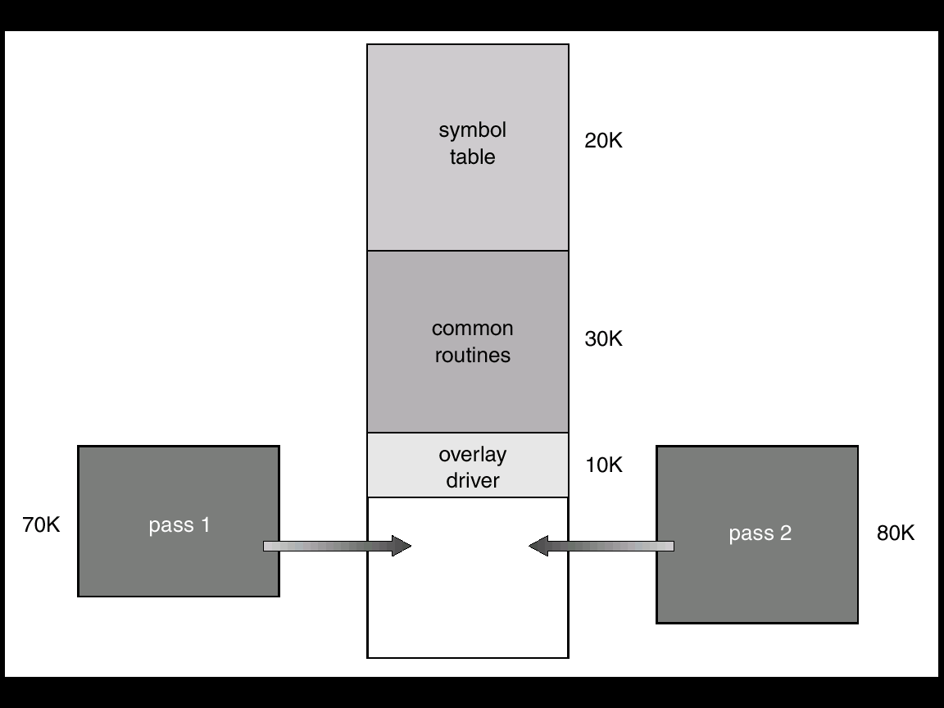
Overlays for a Two-Pass Assembler
After finishing Pass1, the overlay driver reads overlay B, overwriting overlay A, and transfers control to pass 2.
Special loading and linking algorithms are needed to construct overlays.
Writing of overlay driver requires complete knowledge of the program structure.
Limited to microcomputers and embedded systems
Lack hardware support for memory management.

Slide 16
Logical vs. Physical Address Space
The concept of a logical address space that is bound to a separate physical address space is central to proper memory management.
Logical address – generated by the CPU; also referred to as virtual address.
Set of logical addresses generated by a program is called logical address space.
Physical address – address seen by the memory unit.
Set of physical addresses corresponds to logical space is called physical address space.
Logical and physical addresses are the same in compile-time and load-time address-binding schemes; logical (virtual) and physical addresses differ in execution-time address-binding scheme.

Slide 17
Memory-Management Unit (MMU)
Hardware device that maps virtual to physical address.
In MMU scheme, the value in the relocation register is added to every address generated by a user process at the time it is sent to memory.
The user program deals with logical addresses; it never sees the real physical addresses.

Slide 18
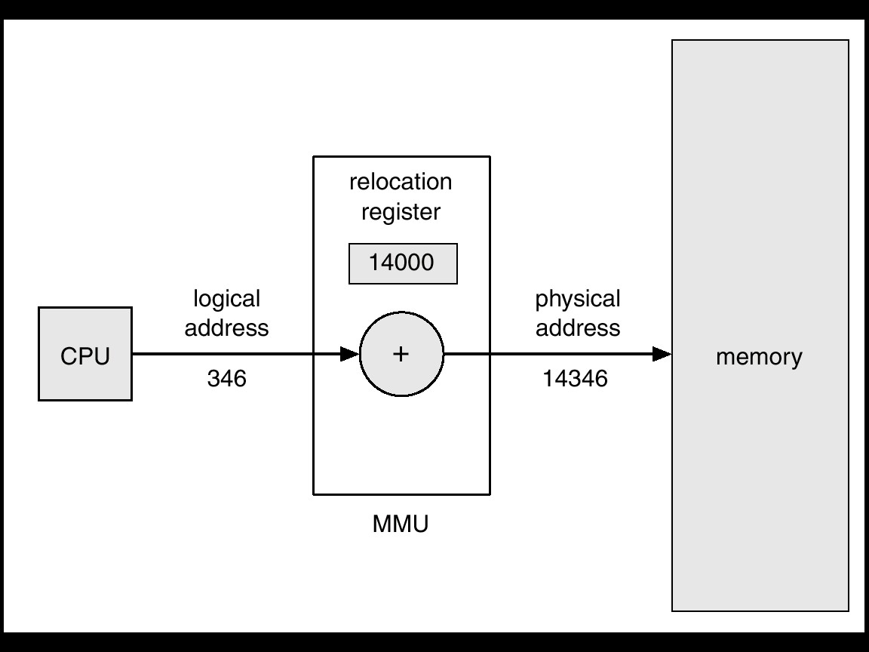
Dynamic relocation using a relocation register

Slide 19
Swapping
Whenever the CPU scheduler decides to execute a process, it calls the dispatcher.
The dispatcher checks whether the process is in main memory.
If the process is not, and there is no free memory, the dispatcher swaps out a process currently in main memory and swaps in the desired process.
Backing store – fast disk large enough to accommodate copies of all memory images for all users; must provide direct access to these memory images.
Roll out, roll in – swapping variant used for priority-based scheduling algorithms; lower-priority process is swapped out so higher-priority process can be loaded and executed.
Major part of swap time is transfer time; total transfer time is directly proportional to the amount of memory swapped.
When a process which is swapped-out swaps-in
Binding during assembly and loading
Process can not be moved to different locations.
Binding during execution
Process can be moved to different locations
Modified versions of swapping are found on many systems, i.e., UNIX, Linux, and Windows.

Slide 20
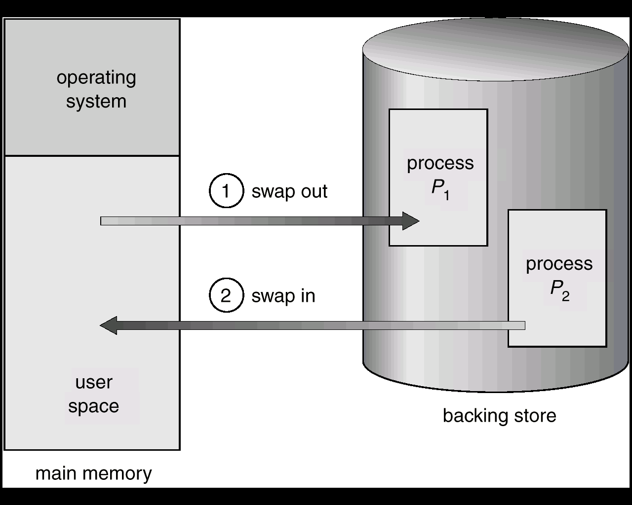
Schematic View of Swapping

Slide 21
Swapping…
A process should be idle to swap.
It should not have any pending I/Os.
Solutions
Never swap a process with pending I/Os
Difficult if the process is accessing asynchronously.
Execute I/O operations into OS buffers.
Transfers between OS buffers to process occur only when the process is swapped in.
UNIX
Swapping is normally disabled.
However, swapping starts if many processes are running and using threshold amount of memory.
Swapping is halted when the load is reduced.
WINDOWS
OS does not provide full swapping.
The scheduler decides when the process should be swapped out.
When the user selects the process, the process is swapped-in.

Slide 22
Contiguous Allocation
0
Main memory usually into two partitions:
Resident operating system, usually held in low memory with interrupt vector.
User processes then held in high memory.
Single-partition allocation
Relocation-register scheme used to protect user processes from each other, and from changing operating-system code and data.
Relocation register contains value of smallest physical address; limit register contains range of logical addresses – each logical address must be less than the limit register.
When a CPU scheduler selects a process from execution, the dispatcher loads the relocation and limit registers with correct values as a part of context switch.
Operating system
user
512K

Slide 23
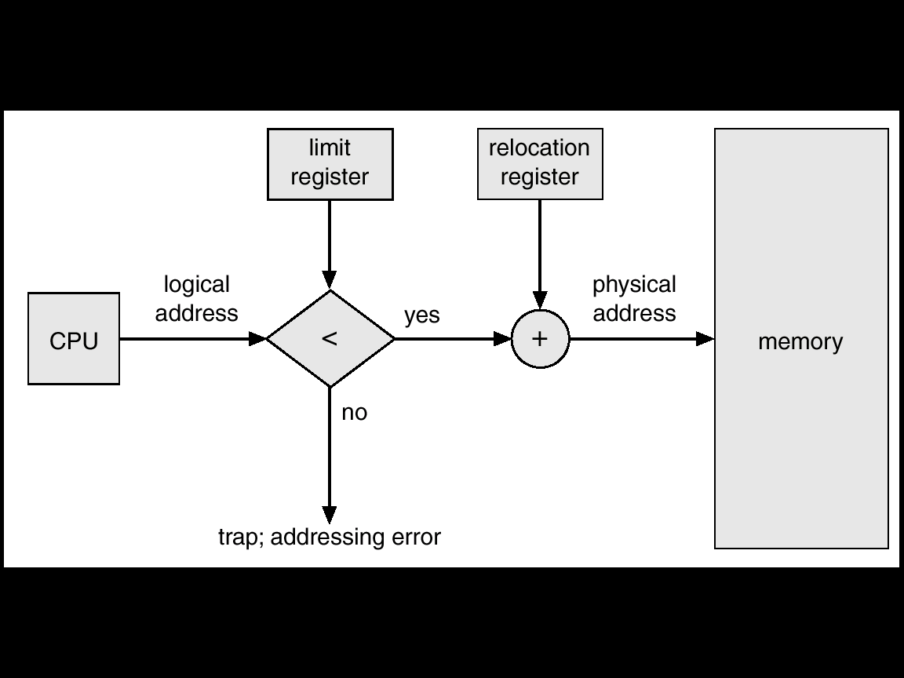
Hardware Support for Relocation and Limit Registers

Slide 24
Contiguous Allocation (Cont.)
Multiple-partition allocation
How to allocate available main-memory to the various processes ?
Simple solution (fixed partition solution): partition the memory
Number of programs= Number of processes.
Not efficient
Improved solution:
Generalization of fixed partition solution.
OS keeps a table indicating which parts of memory are available and which are occupied.
Initially all memory available for a user process.
Free partition or Hole – block of available memory; holes of various size are scattered throughout memory.
When a process arrives, it is allocated memory from free partitions large enough to accommodate it.
Operating system maintains information about: a) allocated partitions b) free partitions (hole)

Slide 25
Contiguous Allocation (Cont.)
At any time a set of holes of various sizes scattered throughout the memory
A free partition large enough for the requesting process is searched.
If the free partition is too large it is split into two: one is allocated to the arriving process and the other is returned to the set of partitions.
When a process terminates, it releases its block of memory, which is then placed back in the set of free partitions.
If the new hole is adjacent to other partitions, we merge these partitions to form a larger hole.
Example:
OS
OS
OS
OS
process 5
process 5
process 5
process 5
process 9
process 9
process 8
process 10
process 2
process 2
process 2
process 2

Slide 26
Contiguous Allocation (Cont.)
Example: 2560K of memory available and a resident OS of 400K. Allocate memory to processes P1…P4 following FCFS.
Shaded regions are holes
Initially P1, P2, P3 create first memory map.
Process | Memory | time
P1 | 600K | 10
P2 | 1000K | 5
P3 | 300K | 20
P4 | 700K | 8
P5 | 500K | 15
0
0
OS
0
0
0
OS
OS
400K
OS
OS
400K
400K
400K
400K
P1
P1
P5
P1
1000K
1000K
900K
1000K
1000K
1000K
P2
P4
P4
P4
P2 terminates
Allocate P4
P1 terminates
Allocate P5
2000K
1700K
1700K
1700K
2000K
2000K
P3
2000K
2000K
2300K
P3
P3
2300K
2300K
P3
P3
2300K
2300K
2560K
2560K
2560K
2560K
2560K

Slide 27
Dynamic Storage-Allocation Problem
Algorithms to search for a free partition of size n.
First-fit: Allocate the first free partition that is big enough.
Best-fit: Allocate the smallest partition that is big enough; must search entire list, unless ordered by size. Produces the smallest leftover hole.
Worst-fit: Allocate the largest partition; must also search entire list. Produces the largest leftover hole.
First-fit and best-fit better than worst-fit in terms of speed and storage utilization.

Slide 28
Fragmentation
External Fragmentation – total memory space exists to satisfy a request, but it is not contiguous.
50 % rule: Given N allocated blocks 0.5 blocks will be lost due to fragmentation.
Internal Fragmentation – allocated memory may be slightly larger than requested memory; this size difference is memory internal to a partition, but not being used.
Consider the hole of 18,464 bytes and process requires 18462 bytes.
If we allocate exactly the required block, we are left with a hole of 2 bytes.
The overhead to keep track of this free partition will be substantially larger than the hole itself.
Solution: allocate very small free partition as a part of the larger request.

Slide 29
Solution to fragmentation
Compaction
Paging
Segmentation

Slide 30
Compaction
Reduce external fragmentation by compaction
Shuffle memory contents to place all free memory together in one large block.
Compaction is possible only if relocation is dynamic, and is done at execution time.
I/O problem
Latch job in memory while it is involved in I/O.
Do I/O only into OS buffers.
Compaction depends on cost.
0
0
OS
OS
400K
400K
P5
P5
900K
100K
900K
1000K
P4
P4
1700K
300K
1600K
2000K
Compact
1900K
P3
P3
2300K
660K
260K
2560K
2560K

Slide 31
Paging
Solution to external fragmentation
Permit the logical address space of the process to be non contiguous, allowing a process to be allocated physical memory whenever the later is available.
Paging is a solution.
Logical address space of a process can be noncontiguous; process is allocated physical memory whenever the latter is available.
Divide physical memory into fixed-sized blocks called frames (size is power of 2, between 512 bytes and 8192 bytes).
Divide logical memory into blocks of same size called pages.
Keep track of all free frames.
To run a program of size n pages, need to find n free frames and load program.
Set up a page table to translate logical to physical addresses.
Internal fragmentation.

Slide 32
Address Translation Scheme
Address generated by CPU is divided into:
Page number (p) – used as an index into a page table which contains base address of each page in physical memory.
Page offset (d) – combined with base address to define the physical memory address that is sent to the memory unit.
Page number is an index to the page table.
The page table contains base address of each page in physical memory.
The base address is combined with the page offset to define the physical address that is sent to the memory unit.
The size of a page is typically a power of 2.
512 –8192 bytes per page.
The size of logical address space is 2^{m} and page size is 2^{n} address units.
Higher m-n bits designate the page number
n lower order bits indicate the page offset.
p
d
Page offset
Page #
m-n
n

Slide 33
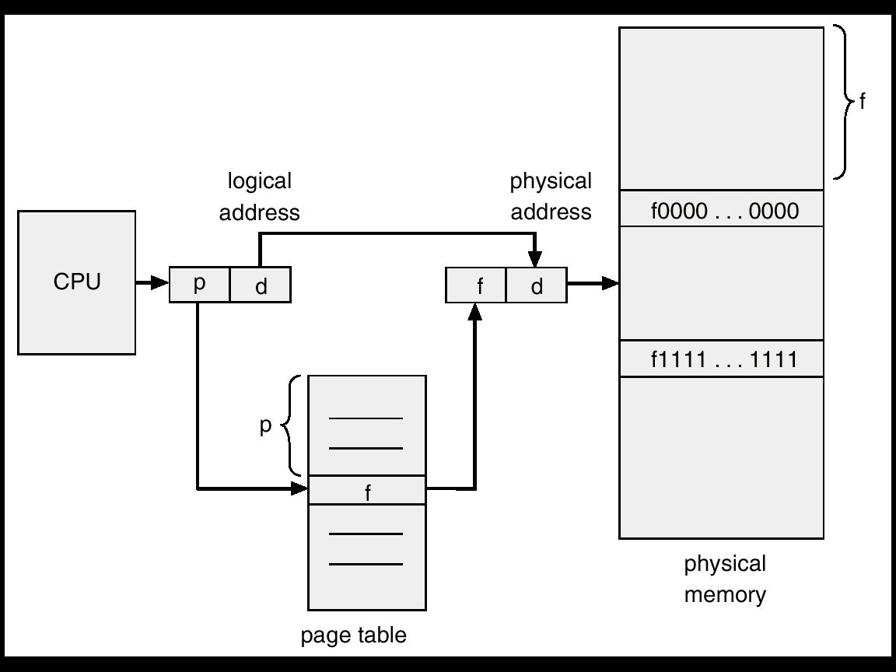
Address Translation Architecture

Slide 34
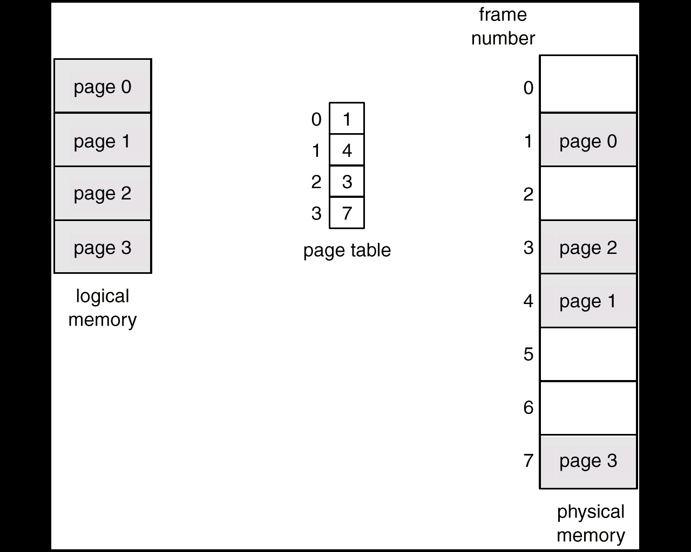
Paging Example
Page size= 4 bytes; Physical memory=32 bytes (8 pages)
Logical address 0 maps 1*4+0=4
Logical address 3 maps to= 1*4+3=7
Logical address 4 maps to =4*4+0=16
Logical address 13 maps to= 7*4+1=29.

Slide 35
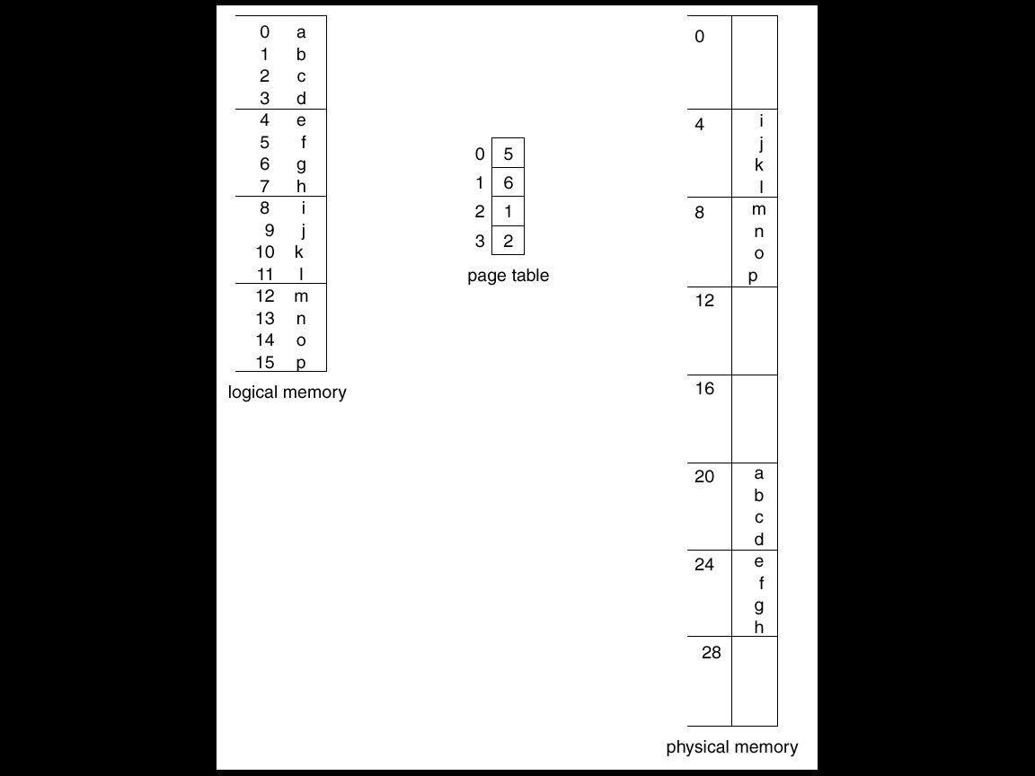
Paging Example
Page size= 4 bytes; Physical memory=32 bytes (8 pages)
Logical address 0 maps 5*4+0=20
Logical address 3 maps to= 5*4+3=23
Logical address 4 maps to =6*4+0=24
Logical address 13 maps to= 2*4+1=9.

Slide 36
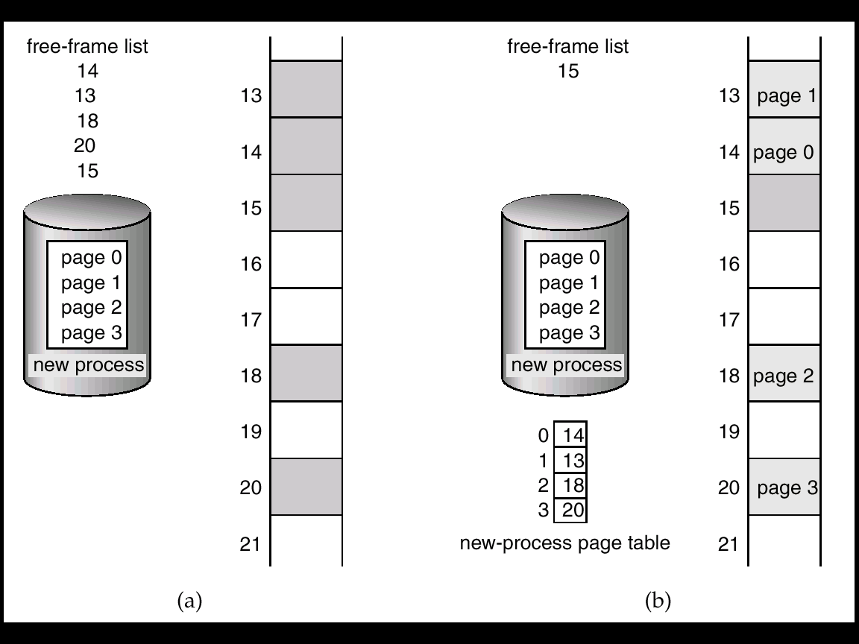
Free Frames
When a process arrives the size in pages is examined
Each page of process needs one frame.
If n frames are available these are allocated, and page table is updated with frame number.
Before allocation
After allocation

Slide 37
More about Paging
Paging separates user’s view of memory and the actual physical memory.
User program views memory as single contiguous space.
In fact, user program is scattered throughout physical memory.
OS maintains copy of the page table for each process. This copy is used to translate logical addresses to physical addresses.
With paging we have no external fragmentation.
We may have some internal fragmentation.
In general, page sizes of 2K or 4K bytes.

Slide 38
Two issues
Speed
Space

Slide 39
Implementation of Page Table
Two options: Page table can be kept in registers or main memory
Page table is kept in main memory due to bigger size.
Ex: address space = 2³² to 2⁶⁴
Page size= 2¹²
Page table= 2³² / 2¹²=2²⁰
If each entry consists of 4 bytes, the page table size = 4MB.
Page-table base register (PTBR) points to the page table.
Page-table length register (PRLR) indicates size of the page table.
PTBR, and PRLR are maintained in the registers.
Context switch means changing the contents of PTBR and PRLR.
In this scheme every data/instruction access requires two memory accesses. One for the page table and one for the data/instruction.
Memory access is slowed by a factor of 2.
Swapping might be better !
The two memory access problem can be solved by the use of a special fast-lookup hardware cache called associative memory or translation look-aside buffers (TLBs)

Slide 40
Translation look-aside buffer (TLB)
TLB is an associative memory – parallel search
A set of associative registers is built of especially high-speed memory.
Each register consists of two parts: key and value
When associative registers are presented with an item, it is compared with all keys simultaneously.
If corresponding field is found, corresponding field is output.
Associative registers contain only few of page table entries.
When a logical address is generated it is presented to a set of associative registers.
If yes, the page is returned.
Otherwise memory reference to page table mode. Then that page # is added to associative registers.
Address translation (A´, A´´)
If A´ is in associative register, get frame # out.
Otherwise get frame # from page table in memory
It may take 10 % longer than normal time.
% of time the page # is found in the associative registers is called hit ratio.
Page #
Frame #

Slide 41
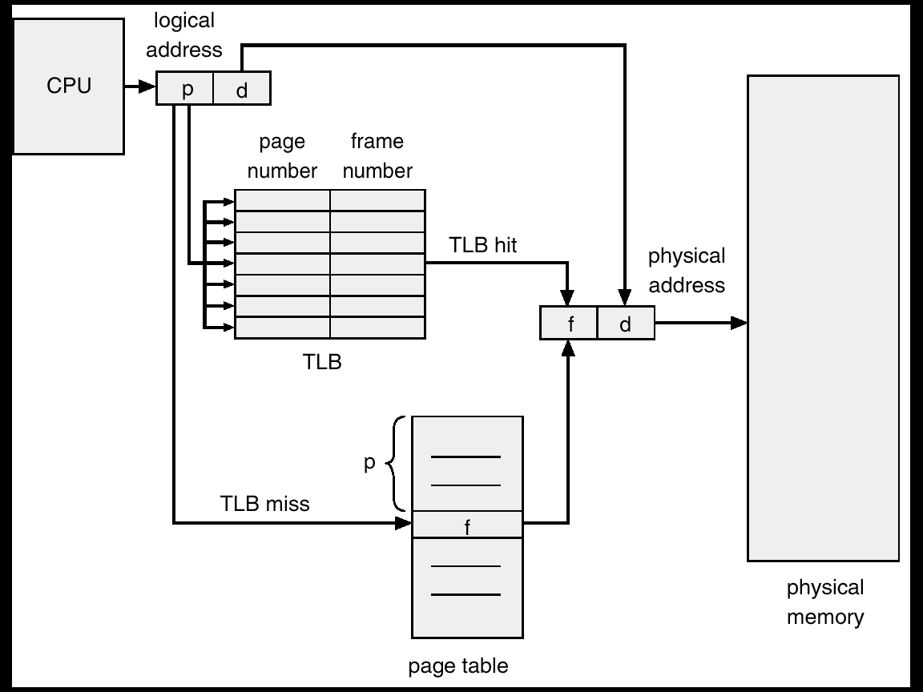
Paging Hardware With TLB

Slide 42
Effective Access Time
If it takes 20 nsec to search the associative registers and 100 nsec to access memory and hit ratio is 80 %, then,
Effective access time=hit ratio*Associate memory access time +miss ratio* memory access time.
0.80 * 120+0.20*220=140 nsec.
40 % slowdown.
For 98-percent hit ratio, we have
Effective access time= 98*120+0.02*220
= 122 nanoseconds
= 22 % slowdown.

Slide 43
Memory Protection
Memory protection implemented by associating protection bit with each frame.
One bit can be assigned to indicate read and write or read-only
An attempt to write read-only page causes hardware trap to OS.
More bits can be added to provide read-only, read-write or execute-only protection.
Valid-invalid bit attached to each entry in the page table:
“valid” indicates that the associated page is in the process’ logical address space, and is thus a legal page.
“invalid” indicates that the page is not in the process’ logical address space.
Illegal addresses can be trapped with valid/invalid bit.
Some systems implement page table length register (PTLR) in case of internal fragmentation.
PTLR is used to check whether address is in valid range or not.

Slide 44
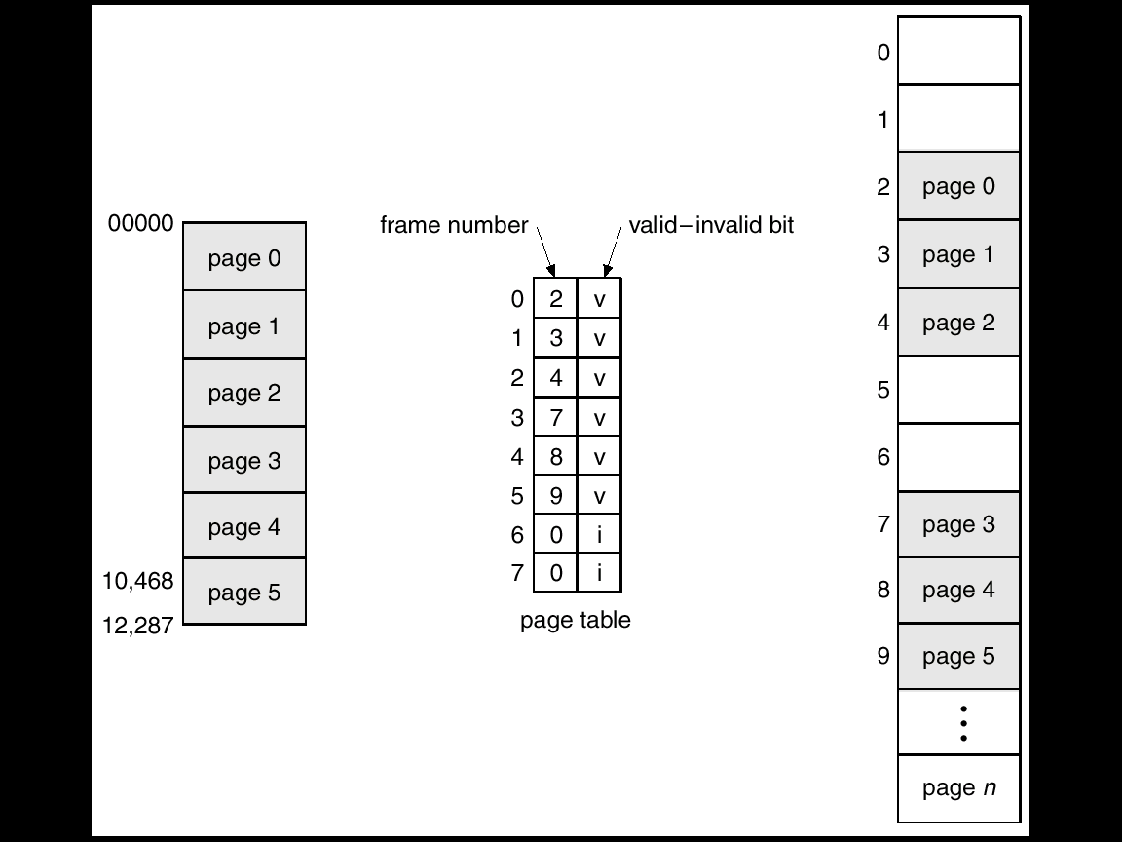
Valid (v) or Invalid (i) Bit In A Page Table

Slide 45
Page Table: Space Issue
Page table:
Each process has a page table associated with it.
The page table has a slot for each logical address regardless of its validity.
Since table is sorted by virtual address, OS calculates the value directly.
However, It consumes more space.
Example regarding space issue: Modern computer systems support a very large address space: 2³² to 2⁶⁴.
Consider a system with 32-bit logical address space. If the page size is 4K, then the page table size is 2¹² entries.
If each entry consists of 4 bytes, then each process may need 4 mega bytes for a page table.

Slide 46
Page Table Structure
Hierarchical Paging
Hashed Page Tables
Inverted Page Tables

Slide 47
Hierarchical Page Tables
Modern computer systems support a very large address space: 2³² to 2⁶⁴.
Consider a system with 32-bit logical address space. If the page size is 4K, then the page table size is 2¹² entries.
If each entry consists of 4 bytes, then each process may need 4 mega bytes.
Solution: Break up the logical address space into multiple page tables.
A simple technique is a two-level page table.
Page table itself is paged.

Slide 48
Two-Level Paging Example
A logical address (on 32-bit machine with 4K page size) is divided into:
a page number consisting of 20 bits.
a page offset consisting of 12 bits.
Since the page table is paged, the page number is further divided into:
a 10-bit page number.
a 10-bit page offset.
Thus, a logical address is as follows: where p_{i} is an index into the outer page table, and p₂ is the displacement within the page of the outer page table.
page number
page offset
p_{i}
p₂
d
10
10
12

Slide 49
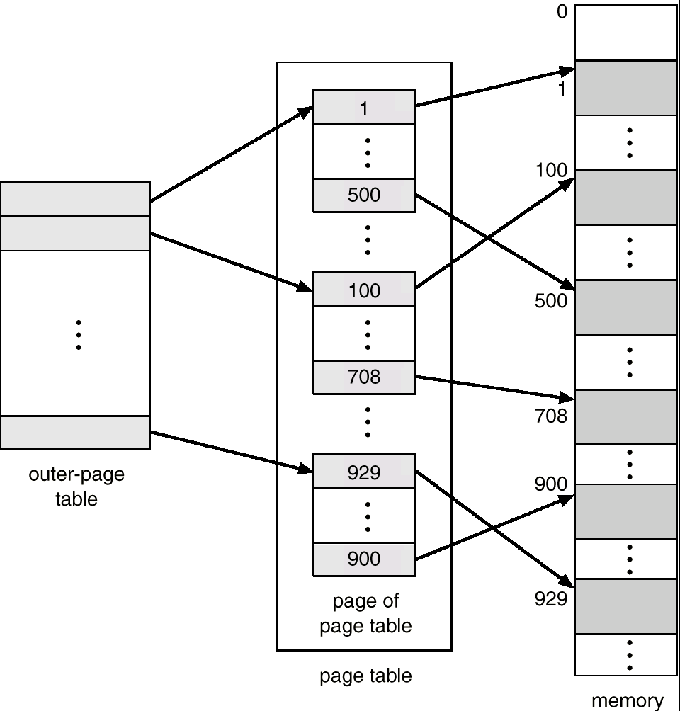
Two-Level Page-Table Scheme

Slide 50
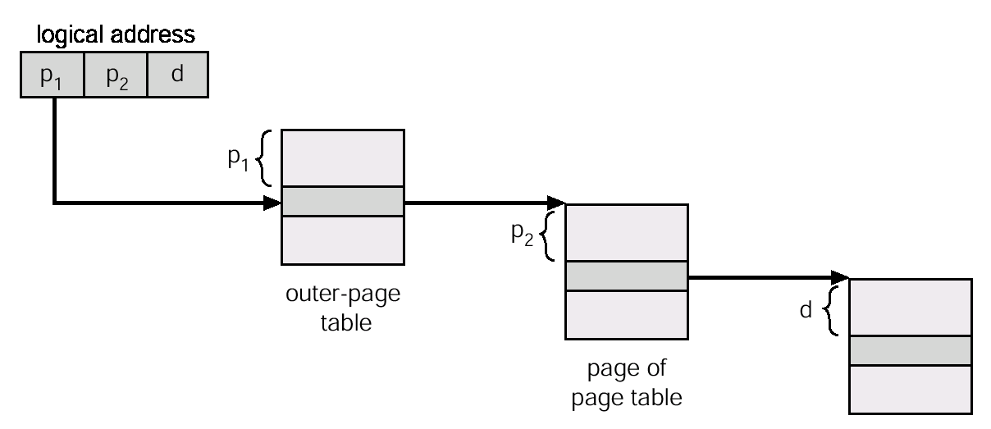
Address-Translation Scheme
Address-translation scheme for a two-level 32-bit paging architecture

Slide 51
Address-Translation Scheme
VAX 32-bit architecture supports a variation of two-level paging scheme
SPARC 32 bit architecture supports 3-level paging scheme.
32-bit Motorola 68030 supports a 4-level paging scheme.
Tradeoff: size versus speed
For 64-bit architectures hierarchical page tables are inappropriate.
For example, the 64-bit UltraSPARC would require seven levels of paging.

Slide 52
Hashed Page Tables
Common in address spaces > 32 bits.
The virtual page number is hashed into a page table. This page table contains a chain of elements hashing to the same location.
Virtual page numbers are compared in this chain searching for a match. If a match is found, the corresponding physical frame is extracted.

Slide 53
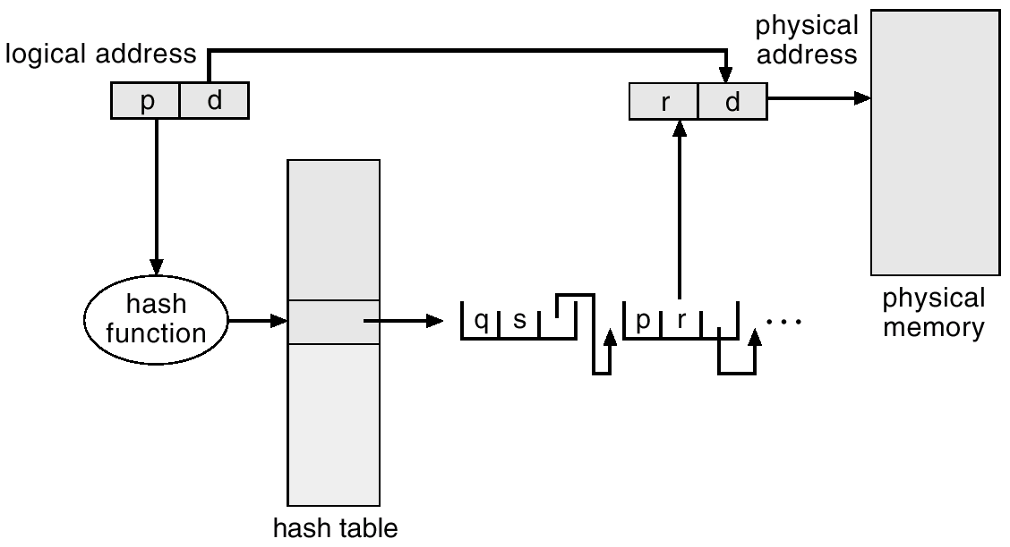
Hashed Page Table

Slide 54

Inverted Page Table
Page table:
Each process has a page table associated with it.
The page table has a slot for each logical address regardless of its validity.
Since table is sorted by virtual address, OS calculates the value directly.
It consumes more space.
Solution: Inverted page table

Slide 55
Inverted Page Table
Solution: Inverted page table
One entry for each real page of memory.
Entry consists of the virtual address of the page stored in that real memory location, with information about the process that owns that page.
Decreases memory needed to store each page table, but increases time needed to search the table when a page reference occurs.
There is only one page table in the system.
Each virtual address space in the the system consists of a triple <Process-id, page #, offset>
When a memory reference occurs part of <process-id, page#> is presented to memory subsystem.
The inverted page table is searched for a match.
Use hash table to limit the search to one — or at most a few — page-table entries.
It is implemented in 64-bit UltraSPARC and PowerPC.
Decreases amount of memory but increases time needed to search the table.

Slide 56
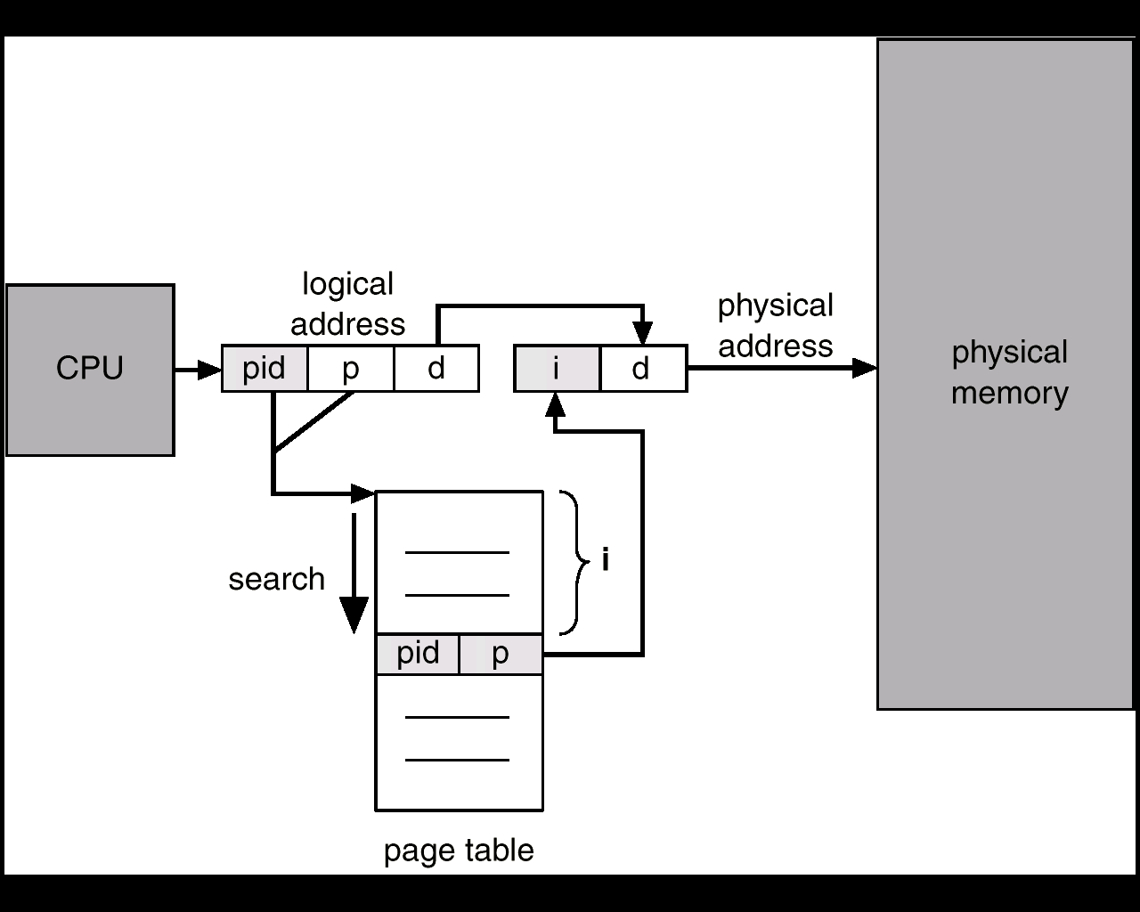
Inverted Page Table Architecture

Slide 57
Shared Pages
Advantage of paging
Paging allows sharing of common code.
Shared code
One copy of read-only (reentrant) code shared among processes (i.e., text editors, compilers, window systems).
Shared code must appear in the same location in the logical address space of all processes.
Private code and data
Each process keeps a separate copy of the code and data.
The pages for the private code and data can appear anywhere in the logical address space.
For example if a system supports text editor and supports 40 users. If the text editor consists of 150K and 50K of data space we need 8000K for the 40 users.
If the code reentrant it can be shared.
Reentrant code is non-self modifying code
It never changes during execution
Ex: compilers, window system, DBS and so on can be shared.

Slide 58
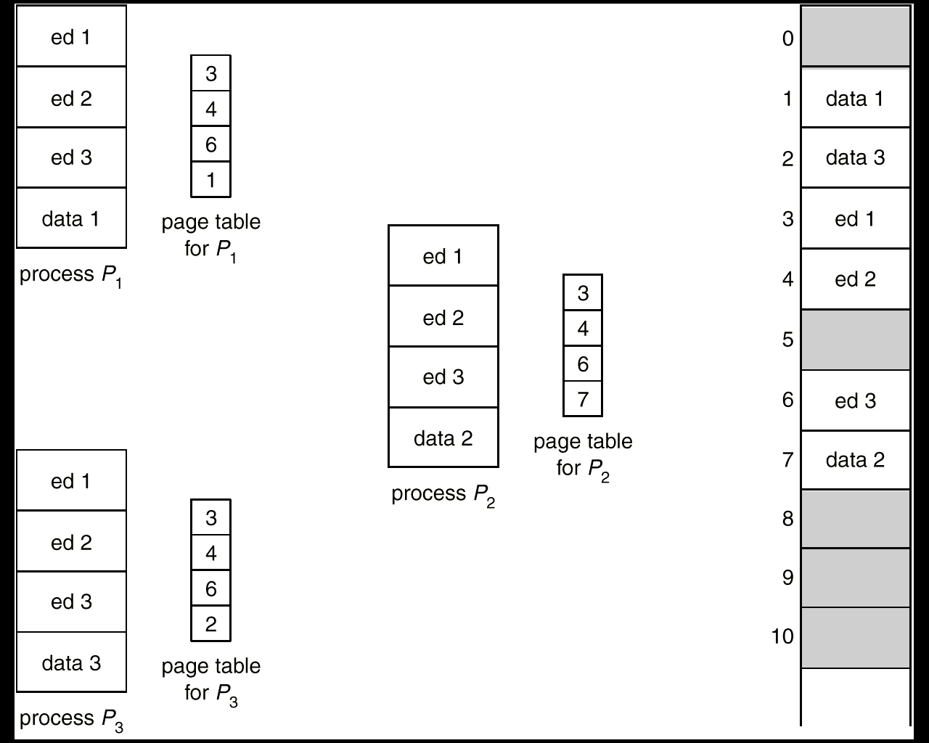
Shared Pages Example

Slide 59
Segmentation
Paging issues
Space: Size of page table
Searching time
Segmentation is a memory-management scheme that supports user view of memory.
Users prefer to view memory as a collection of variable-sized segments without any ordering.
Logical address space is a collection of segments.
Each segment has name and length.
The address specify segment name and length.
A program is a collection of segments. A segment is a logical unit such as:
main program,
procedure,
function,
method,
object,
local variables, global variables,
common block,
stack,
symbol table, arrays

Slide 60
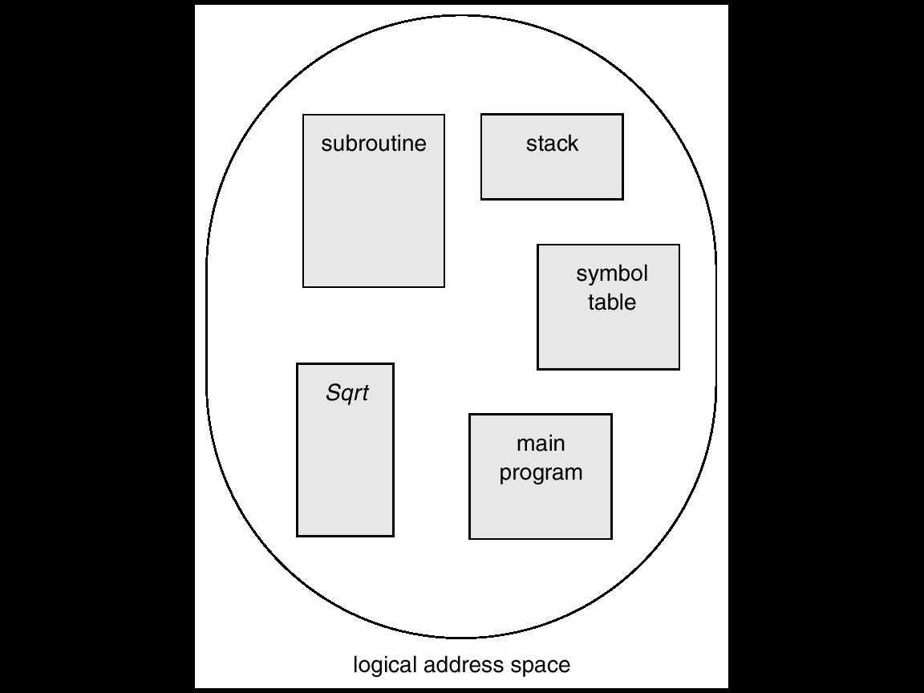
User’s View of a Program

Slide 61
Logical View of Segmentation
1
1
4
2
3
4
2
3
user space
physical memory space

Slide 62
Segmentation Architecture
Logical address consists of a two tuple:
<segment-number, offset>,
Segment table – maps two-dimensional physical addresses; each table entry has:
base – contains the starting physical address where the segments reside in memory.
limit – specifies the length of the segment.
Segment-table base register (STBR) points to the segment table’s location in memory.
Segment-table length register (STLR) indicates number of segments used by a program;
segment number s is legal if s < STLR.

Slide 63
Segmentation Architecture (Cont.)
Relocation.
dynamic
by segment table
Sharing.
shared segments
same segment number
Allocation.
first fit/best fit
external fragmentation

Slide 64
Segmentation Architecture (Cont.)
Protection. With each entry in segment table associate:
validation bit = 0 ⇒ illegal segment
read/write/execute privileges
Protection bits associated with segments; code sharing occurs at segment level.
Since segments vary in length, memory allocation is a dynamic storage-allocation problem.
A segmentation example is shown in the following diagram

Slide 65
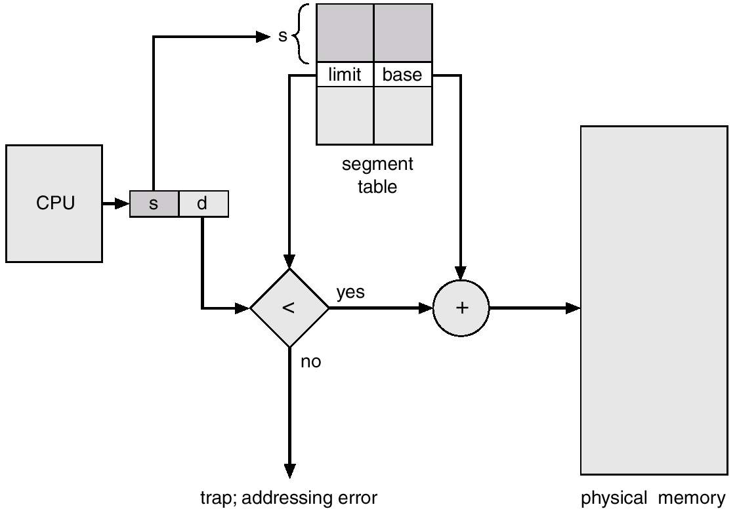
Segmentation Hardware

Slide 66
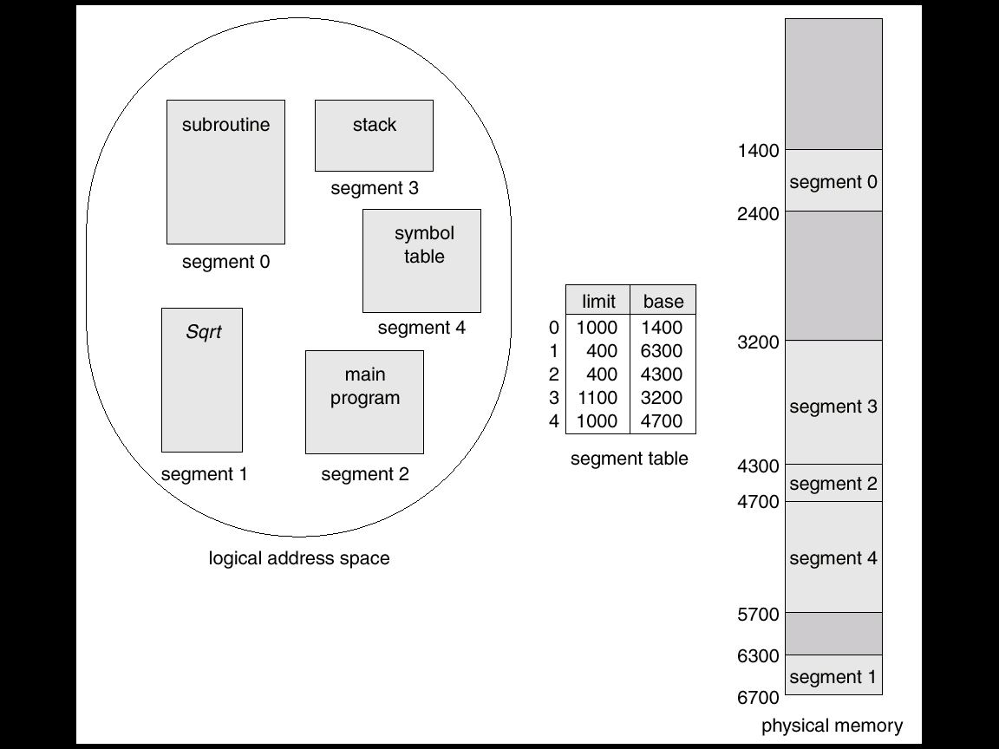
Example of Segmentation

Slide 67
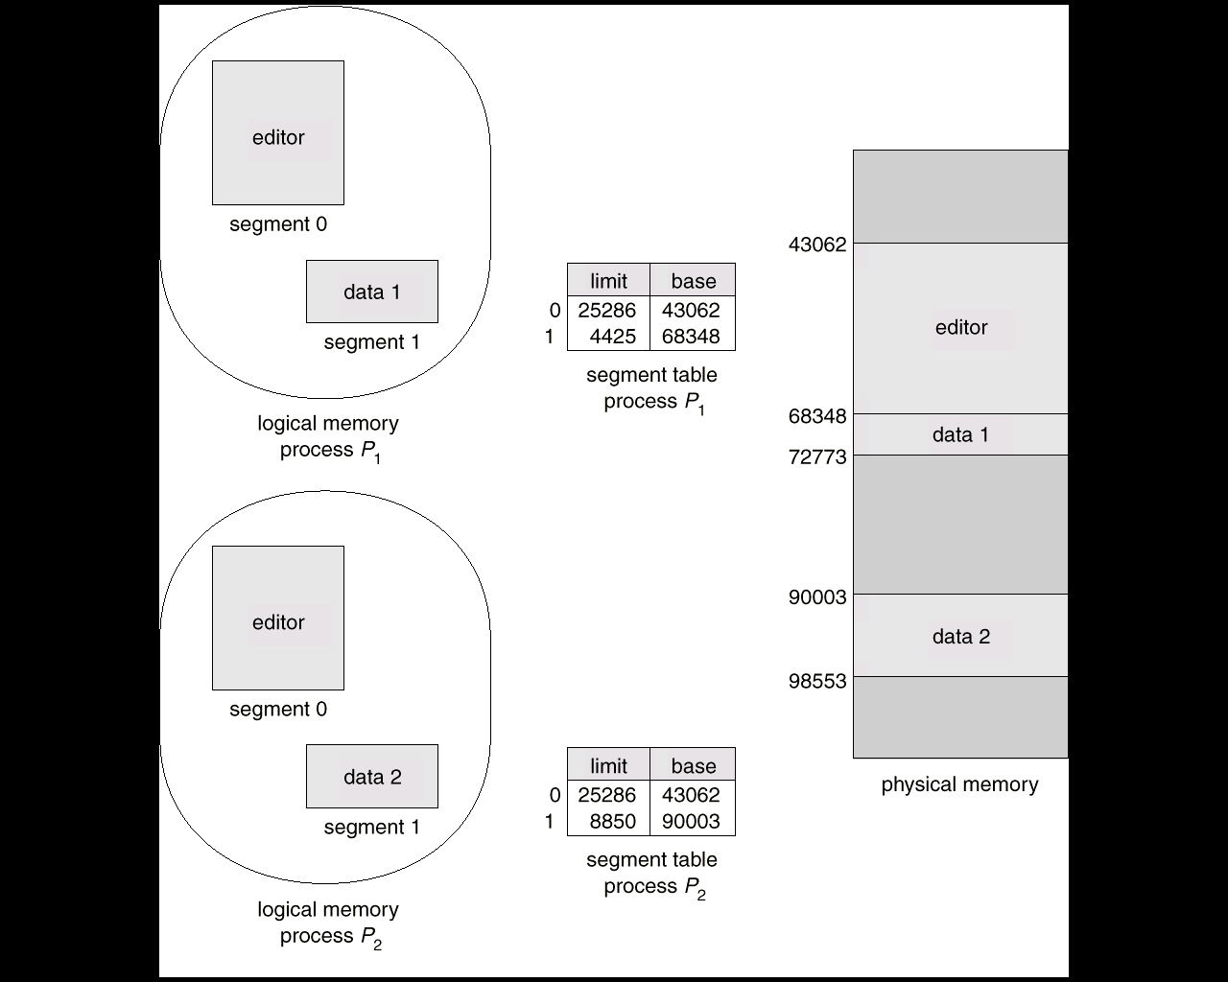
Sharing of Segments

Slide 68
Segmentation with Paging – MULTICS
The MULTICS system solved problems of external fragmentation and lengthy search times by paging the segments.
Solution differs from pure segmentation in that the segment-table entry contains not the base address of the segment, but rather the base address of a page table for this segment.

Slide 69
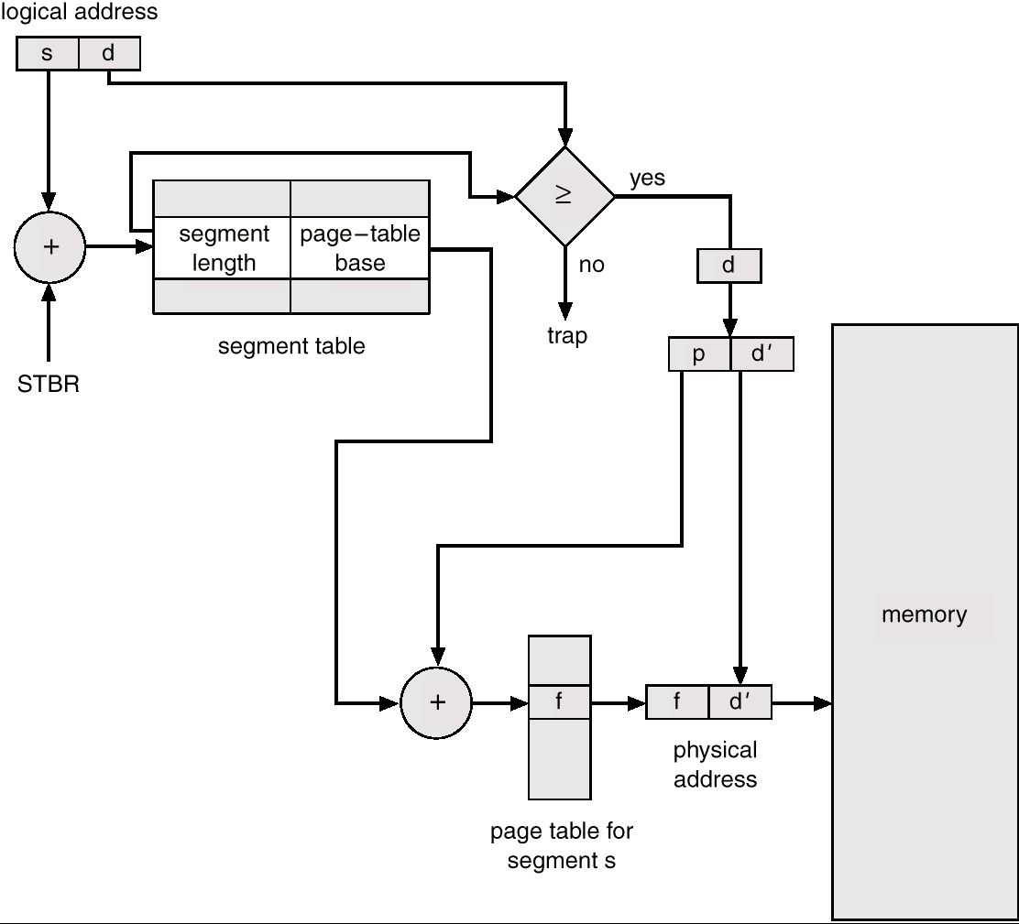
MULTICS Address Translation Scheme

Slide 70
Segmentation with Paging – Intel 386
As shown in the following diagram, the Intel 386 uses segmentation with paging for memory management with a two-level paging scheme.

Slide 71
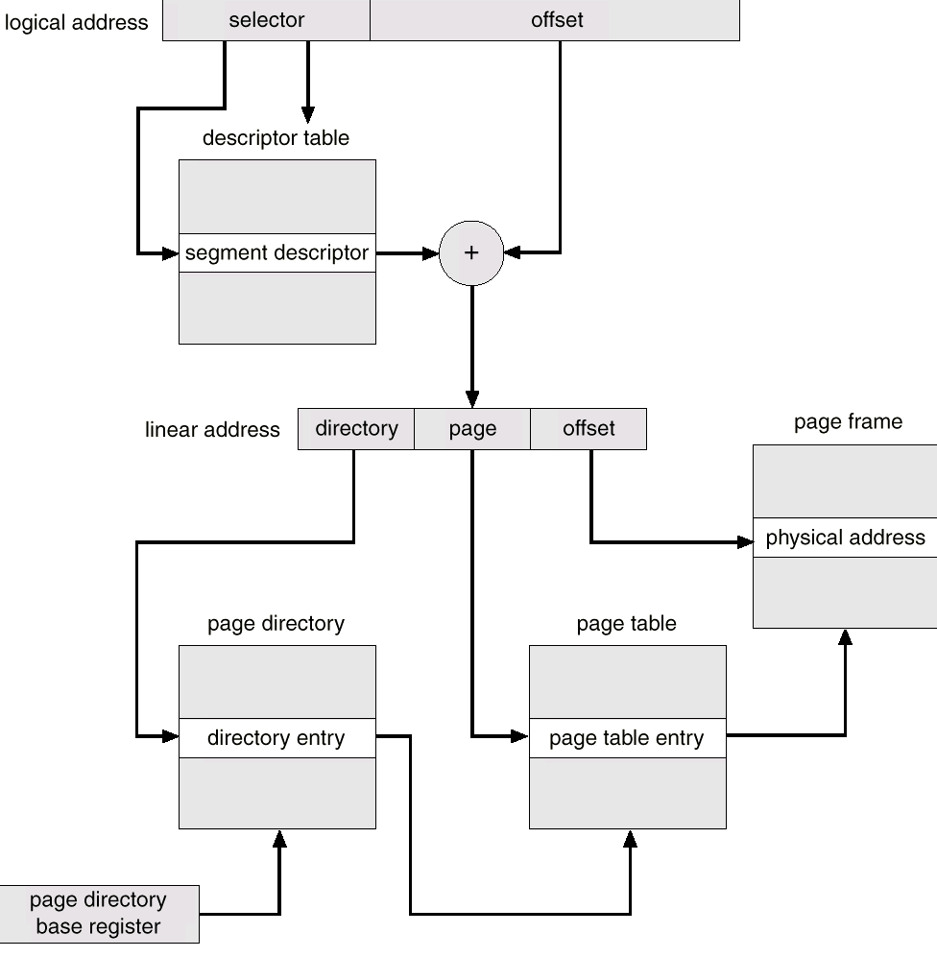
Intel 30386 Address Translation

